Slide 1
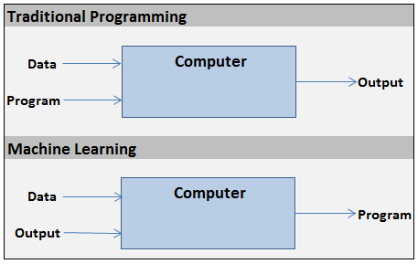

Slide 2


x₁
w₁
Summation
Activation (i.e. step)
x₂
w₂
x₃
w₃
output
x₄
w₄
Σ
y
inputs
w₅
x₅
.
.
.
w_{n}
h(X) = x₁w₁ + x₂w₂ + … + x_{n}w_{n}
x_{n}
1, if h(X) >= 0
y =
weights
0, if h(X) < 0

Slide 3
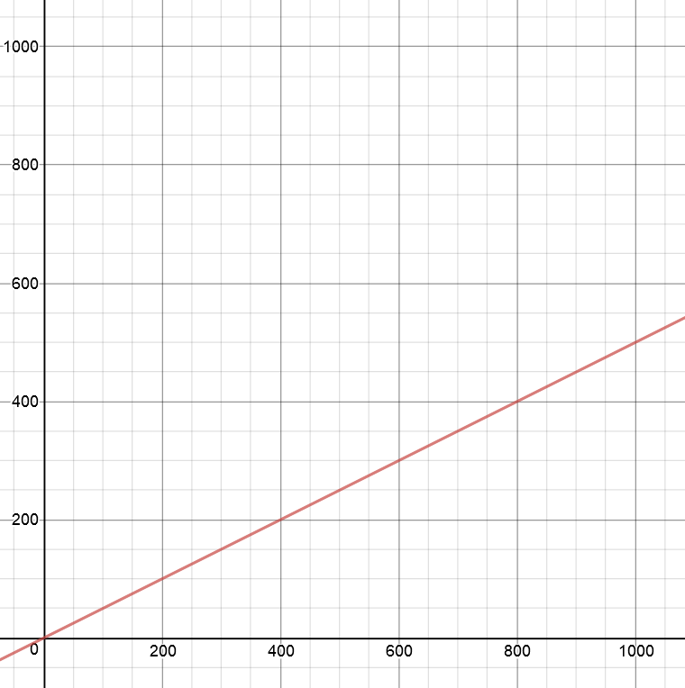
point to test
2nd input –
y-coordinate
y = 0.5 * x
1st input –
x-coordinate

Slide 4
x-coordinate
x₁
w₁
output
Σ
y
inputs
w₂
x₂
weights
y-coordinate

Slide 5
learning rate – small number
(i.e. 0.01)
x-coordinate
w₁ = w₁ – error * x₁ * α
x₁
w₁
error =
Σ
y - ŷ
Inputs
w₂
actual
value
guess
x₂
w₂ = w₂ – error * x₂ * α
y-coordinate

Slide 6
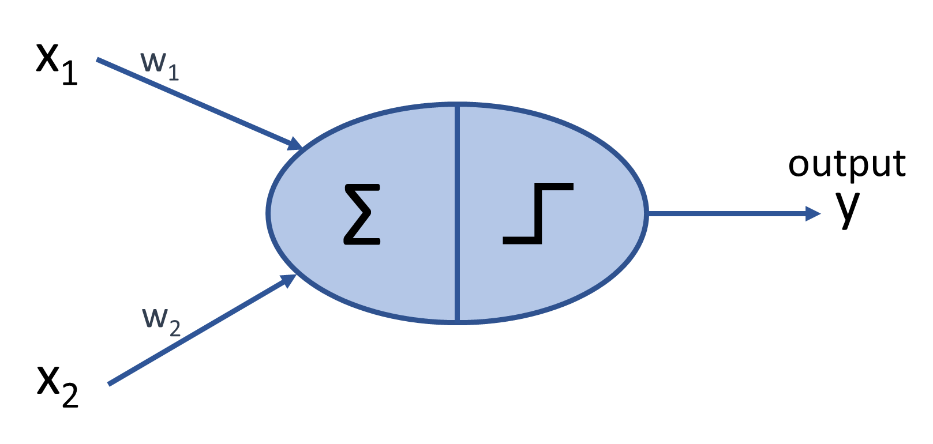
After 1000 training points:
w1 = -18.29
w2 = +36.82
-18.29x + 36.82y = 0
y = (18.29/36.82)x
y = 0.4969 * x
accuracy 99.9%
y = 0.5 * x

Slide 7
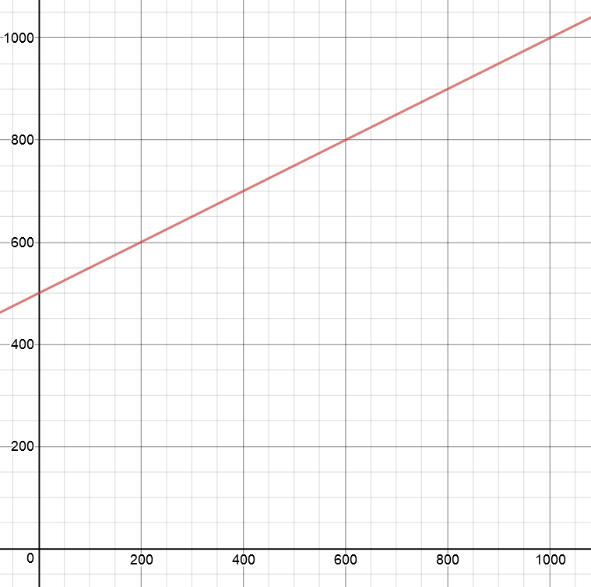
2nd input –
y-coordinate
y = 0.5 * x + 500
point to test
1st input –
x-coordinate

Slide 8
x-coordinate
x₁
w₁
y-coordinate
output
w₂
Σ
y
x₂
inputs
w₃
x₃
bias (always = 1)

Slide 9
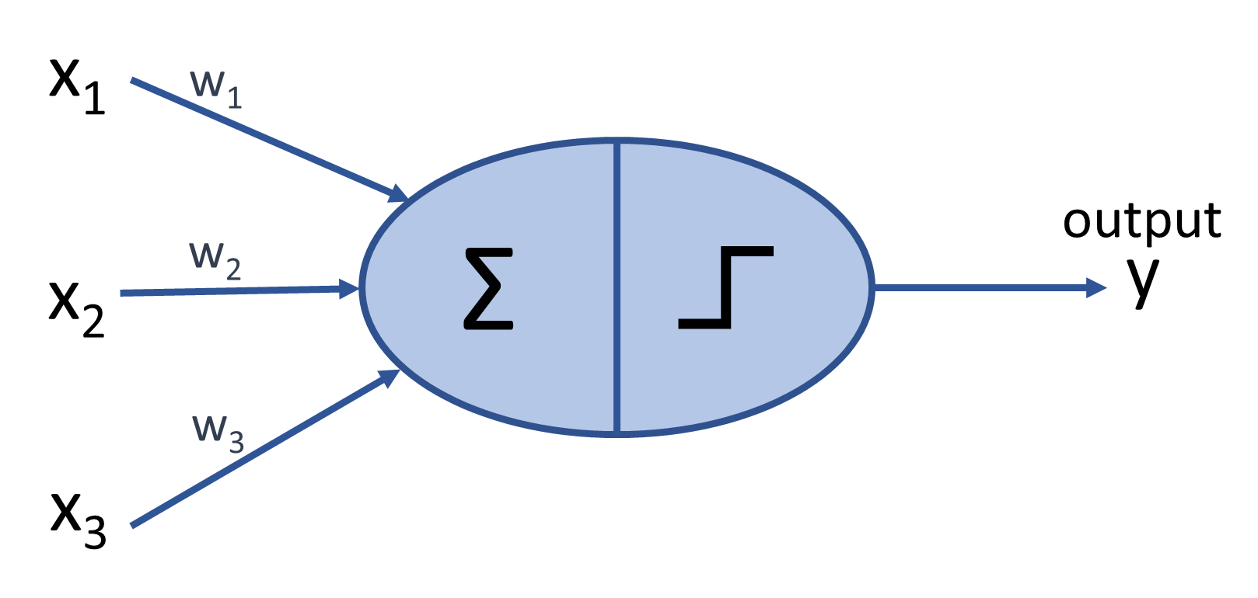
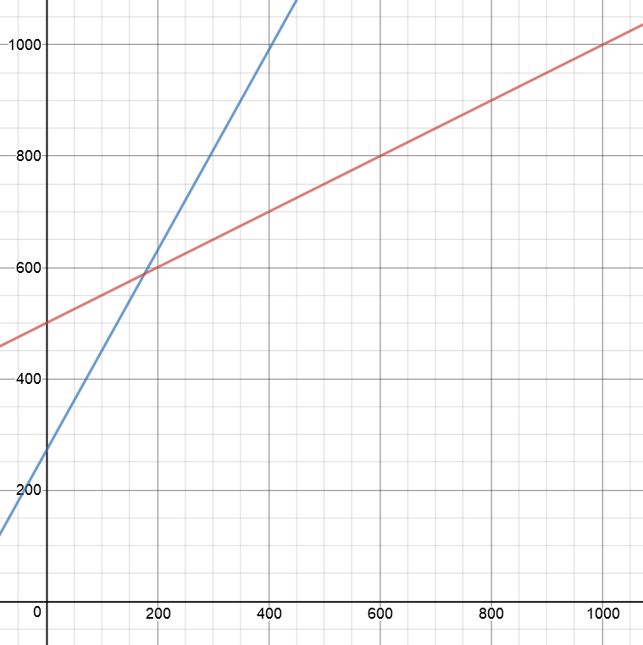
y = 0.5 * x + 500
After 10 million training points:
w1 = -28.5
w2 = +16.0
w3 = -4329.5
-28.5x + 16.0y -4329.5 = 0
y = (28.5/16.0)x + (4329.5/16.0)
y = 1.8 * x + 270.6
accuracy 85.7%

Slide 10
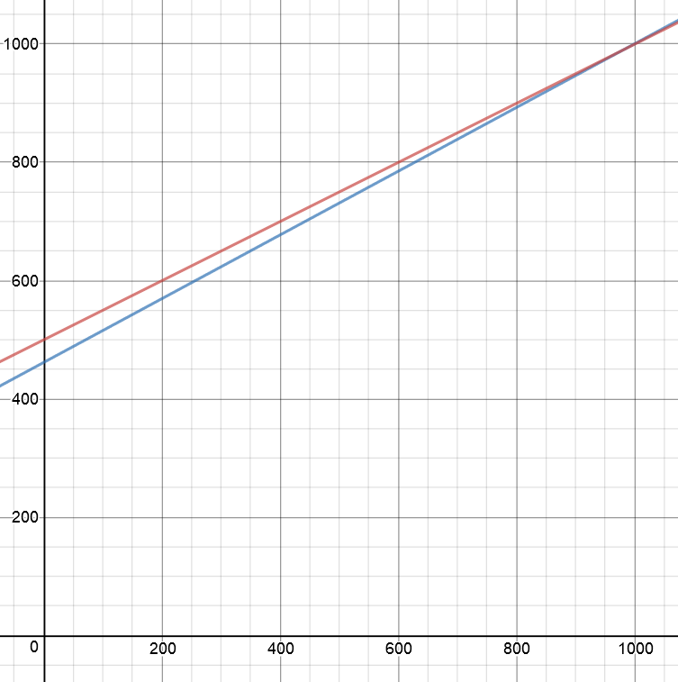
y = 0.5 * x + 500
After 100 million training points:
w1 = -19.20
w2 = +35.63
w3 = -16457.09
-19.20x + 35.63y -16457.09 = 0
y = (19.20/35.63)x + (16457.09/35.63)
y = 0.5389 * x + 461.889
accuracy 97.7%

